Slide 1
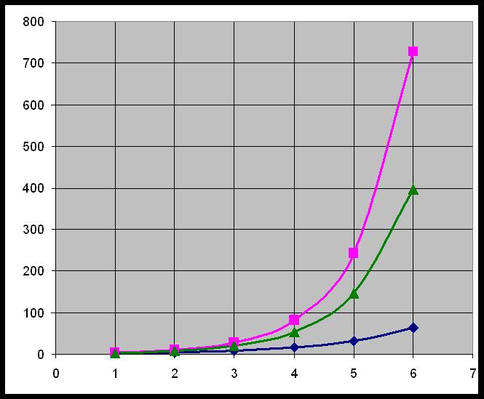
Functions and Graphs

Slide 2
Relations
Last week we had relations – a connection between 2 sets which is a subset of the cross product.
The relation R = {(f,s): f ∈ F, s ∈ S, f is eaten by s }
is {(Oranges, Peter), (Apples, Peter), (Bananas, Paul), (Bananas, Mary)}
Oranges
Apples
Bananas
Peter
Paul
Mary
F = {Fruit}
S = {Singers}

Slide 3
Relations
The cross product |FxS| = 9 and has all possible combinations of (f,s) where f ∈ F, s ∈ S,
i.e all possible pairs of Fruit and Singers
R is a subset of this and |R| = 4
Oranges
Apples
Bananas
Peter
Paul
Mary
F = {Fruit}
S = {Singers}

Slide 4
Mappings
Mappings introduced a sense of ‘direction’ from inputs to outputs
A mapping FROM a set A TO a set B
RANGE
DOMAIN
CODOMAIN

Slide 5
Functions
Special Mappings with 4 rules
Every passenger has a destination
Some destinations don’t have any visitors
No passenger goes to 2 destinations
Many visitors can go to the same place

Slide 6
Definition of a Function
Every element of the domain must be sent to an element in the co-domain.
Some elements of the co-domain may fail to have any element of the domain sent to them.
No element of the domain is sent to more than one element of the co-domain.
Elements of the co-domain may have more than one element of the domain sent to them

Slide 7
Types of Function
Let f be a function from set A to set B
i.e. f:A→B
Domain A Codomain B
Domain A Codomain B
ONTO
ran f
= codomain
INTO
ran f
codomain
f
codomain
range

Slide 8
Types of Function
Let f be a function from set A to set B
i.e. f:A→B
MANY-1
1-1
Domain A Codomain B
Domain A Codomain B

Slide 9
A picture is worth a 1000 words
We have seen that showing information on a graphical display of some sort can help us to see relationships
Places
Greenwich x x x x
Lewisham x x x x
Ahmed Colin Joan Paul
Students

Slide 10

getting a total of under 5
6 ordered pairs are in this set

Slide 11
Special Functions
Some functions have special properties because of their domain and codomain
This means we can represent them in graphs
We use the pairs of each element of the domain and its image as a point to plot i.e. we plot (x,f(x)) as a pair
This means we can then find out other properties of the function by looking at the ‘picture’

Slide 12
So we can have a function f : R → R
(here the domain and codomain are Real numbers)
f : x → 3x + 1 or f(x) = 3x+1
(every x of the domain is tripled then 1 is added)
Sometimes we use y for the image of x
The image of x is (3x+1) so leading to
us to use y = 3x+1 to describe this function
f
7
2
x
3x+1 =y
5.2
16.6

Slide 13
The plot thickens!
We have already looked at functions defined
by a formula, now we will turn these into graphs
Let f(x) = 2x where domain f is {-2,-1,0,1,2}
Domain elements | x | -2 | -1 | 0 | 1 | 2
Range images | f(x) | -4 | -2 | 0 | 2 | 4
Traditionally we plotted on graph paper using domain and image points as ordered pairs
Now more commonly plotted using a graphical calculator or a package.
Note this is NOT a line and only has 5 data points

Slide 14
Domain x Codomain y
f(x) = 2x+1 or y = f(x) so y = 2x+1
f(2) = 5 or when x = 2 y = 5 (2,5)
(2,5)
2 across 5 up
y
Origin (0,0)
x is a cross

Slide 15
Plotting by hand
To plot f :x→5x -1 if the domain and codomain are given as R then choose sample values for x
X | -4 | -3 | -2 | -1 | 0 | 1 | 2
y = f(x) | -21 | -16 | -11 | -6 | -1 | 4 | 9
This is a continuous graph as we can choose any values from R to ‘fill the holes in’

Slide 16
Sketch the following
f(x) = 2x +3
f(x) = 7x
y = 2(x+3)
x+y = 8

Slide 17
e.g., Using Excel for y = 5x-1
Put the x values in col A and the formula in colB
Use the xy scatter with lines to get a joined up plot

Slide 18
Straight lines
Straight lines can always be written in the form
f(x) = mx+c
Usually use y = mx + c
m gradient c intercept
The finished graph can be used to find f(x)
for values in the domain not chosen and
also to find f ⁻¹(y) for selected image points.

Slide 19
Find f (-1.5)
What is y when x is 4.2?
What is x when y = 4.5?
Can you guess f?
2.25
5.1
3
y = 0.5x + 3

Slide 20
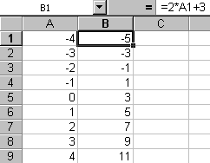
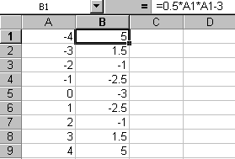

If this represents the function y = 2x+3 with a domain
{x: -4<x<4}
What does the excel spreadsheet below represent?
$y = \frac{x2}{2} – 3$
What will the graph look like?

Slide 21
Cup or Cap?
This is known as a quadratic as it has an x² as its highest power and it is always a curve

Slide 22
Quadratic
In general y = ax² + bx + c intercept still c
If factorising y = (x-p)(x-q)
roots p & q are where the curve crosses the x axis
a positive
a negative

Slide 23
Sketch time
Sketch (don’t plot) the following
y = 2x+7
y = x² -2
y = -x² + 4
y = 3x-11
y = -x/2 + 3
y = x² + 4x +3
y = x² + 2x

Slide 24
Growth and decay
The germs on a tea
towel multiply by 2
every 10 minutes.
If I start with 1 germ
how soon do I get over 1000?
time | 0 | 10 | 20 | 30 | 40 | 50 | 60
germs | 1 | 2 | 4 | 8

Slide 25
Time | 0 | 10 | 20 | 30 | 40 | 50 | 60 | 70 | 80 | 90 | 100
Germs | 1 | 2 | 4 | 8 | 16 | 32 | 64 | 128 | 256 | 512 | 1024 UGH!
This sort of growth is known as Exponential
as it is growing in proportion to powers of 2
or with the exponent of 2
What we have here is y = 2^{x}
x | 0 | 1 | 2 | 3 | 4 | 5 | 6 | 7 | 8 | 9 | 10
y | 1 | 2 | 4 | 8 | 16 | 32 | 64 | 128 | 256 | 512 | 1024

Slide 26
This is the classic growth shape of an exponential function.

Slide 27
We can plot y = 3^{x} in a similar way.
More usually we need y = e ^{x}(e ≈ 2.7)
This will lie between the other two curves.

Slide 28
Reflections
(-x,y)
(x,y)
(-x,-y)
(x,-y)

Slide 30
Reflecting exponentials
By considering reflections we can easily draw using y = e ^{x}
its companions y = e ^{-x} y = -e ^{x} and y = -e ^{-x}
y = e ^{x}
y = e -^{x}
y = -e -^{x}
y = -e ^{x}

Slide 31
Inverting Functions
A function is a special mapping from x→y
An inverse function
(if it exists) maps y→x
e.g. if f:x→2x
then f ⁻¹ : x →x/2
These are reflections in the line
y = x
As we are swapping y for x

Slide 32
If f(x) = n^{x} then the inverse function is f⁻¹(x) = log_{n} x
Because you are unexponentialling from a certain number
logarithms must have a certain ‘base’
e.g. 8 = 2³ therefore log₂ 8 = 3
100 = 10² therefore log₁₀100 = 2
p = r^{q} therefore log_{r} p = q
20.086 = e^{x} therefore log_{e}20.086= x
As this last example is a special case using e
log_{e} are designated ‘natural’ logarithms and written ln
On the calculator log₁₀ and ln are both given
to use other logs you must use a change of base rule.
One of the advantages of using logs was that as they are related to indices multiplication and division could be replaces by addition and subtraction.

Slide 33
Graph of lnx inverse of e^{x}
y = e ^{x}
y = ln x

Slide 34
Going round in circles
Measuring the amount of turn – angle
Quarter turn
Half turn
Full turn
Also in degrees
90, 180, 360
Radian measure
360º = 2π radians
180º = π radians

Slide 35
Degrees and Radians
Radian measure is used a lot in CS&N with signals etc.
When using sine cosine functions it is better to use radians

Slide 36
Sine function
Circular motion converted into wave form we plot sint against t
Using t as it is usually time
-2π
-π
0
π
2π
3π
4π
t

Slide 37
Amplitude, period & cycle
Amplitude
= 1 for sint
-2π
-π
0
π
2π
3π
4π
t
period = length of one cycle

Slide 38
Cosine- a sine wave a bit late
-2π
-π
0
π
2π
3π
4π
t
Sine
Cosine

Slide 39
Further transformation
starting with a
basic graph of a
function we can
use various
transformations to
produce
related functions
y = f(x)
2
1
4

Slide 40
y = f(x)
Multiplying the whole function by a scalar
Stretching on the y axis
(if 0 to 1 contracts)
2
y = 3f(x)
1
4
6
1
4

Slide 41
y = f(x)
Multiplying the x by a scalar
Contracting on the x axis
(if 0 to 1 expands)
2
y = f(3x)
1
4
2
1
4

Slide 42
y = f(x)
Adding a constant term
Shifts the graph along the x axis + to the left
and – to the right
2
y = f(x) -3
1
4
2
1
7

Slide 43
Transforming the basic sine curve
Using a factor of 3 outside the function stretches the curve to amplitude 3
3
3sin4πt
0
0.5
1
-3
Using a 4π scalar multiplication makes the curve cross at
2 π/4 π = 0.5
Amplitude = 3 period = 0.5 = 1/2 frequency = 1/period
= 1/1/2 = 2

Slide 44
Functions of two values f(x,y)
All the functions we have had here start with a single valued domain but we have dealt with two place predicates and we have dealt with multivalued functions in programming
x
f(x,y)
y

Slide 45
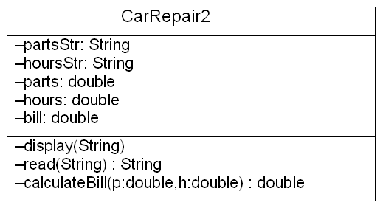
Functions in programming
We use the term in programming when we send parameters into a function method like Calculate Bill which returns the answer

Slide 46
Calling a function
If you want to use a function in programming you must first define what it does and then call it in an appropriate way expecting to do something with the return answer.
Some methods are really just subroutines like ‘display’ which don’t return any value

Slide 47
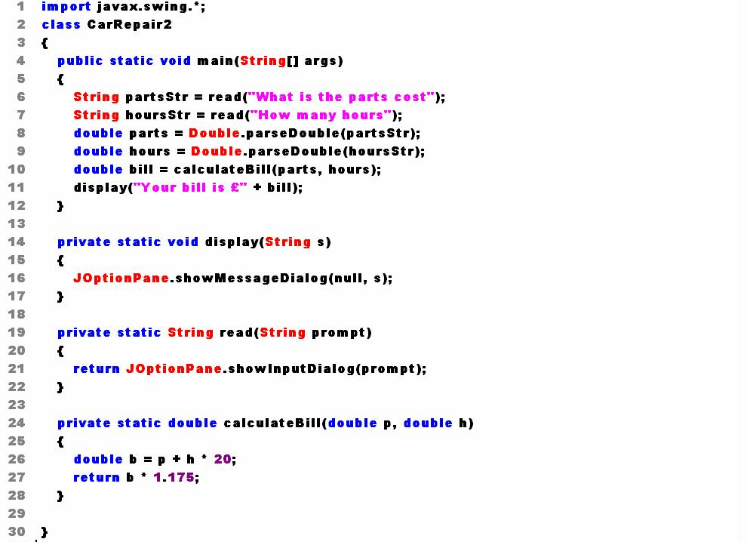
parts
calculateBill
bill
bill
hours
p
b
(p+h*20)*1.175
h

Slide 48
Tutorial
Go to the correct tutorial ☺
Do go to a tutorial ☺
Finish functions tutorial questions from notes
Complete at home if no time to finish in tutorial
Keep tutorial work to help revise for exam at end of course and to help with assignment …
Attendance is being monitored … make the most of the timetabled sessions you have this term

